Slide 1


Data Science Level 1
Hung Nguyen
TIC Data Team Lead
1

Slide 2
Course objective
Theory
Deeply understand about Data Science:
What is DS
What DS [can] do
How to be a DS
Practice
Build an end-to-end predictive model

Slide 3
Course syllabus
Session 1
Session 2
Session 3
Session 4
Data Science introduction
Data science project cycle
Basic concepts of statistics
Intro duction to Python
Data manipulation with Python - Pandas
Data Visualization with Python - Matplotlib
Machine Learning with Scikit-Learn – build model
Model evaluation
Basic algorithms
PoCs planning
PoCs review:
Prediction with linear regression
Classification with logistic regression

Slide 4
Data Science Level 1
-- Session 1--
Introduction
Hung Nguyen
TIC Data Team Lead
4

Slide 5
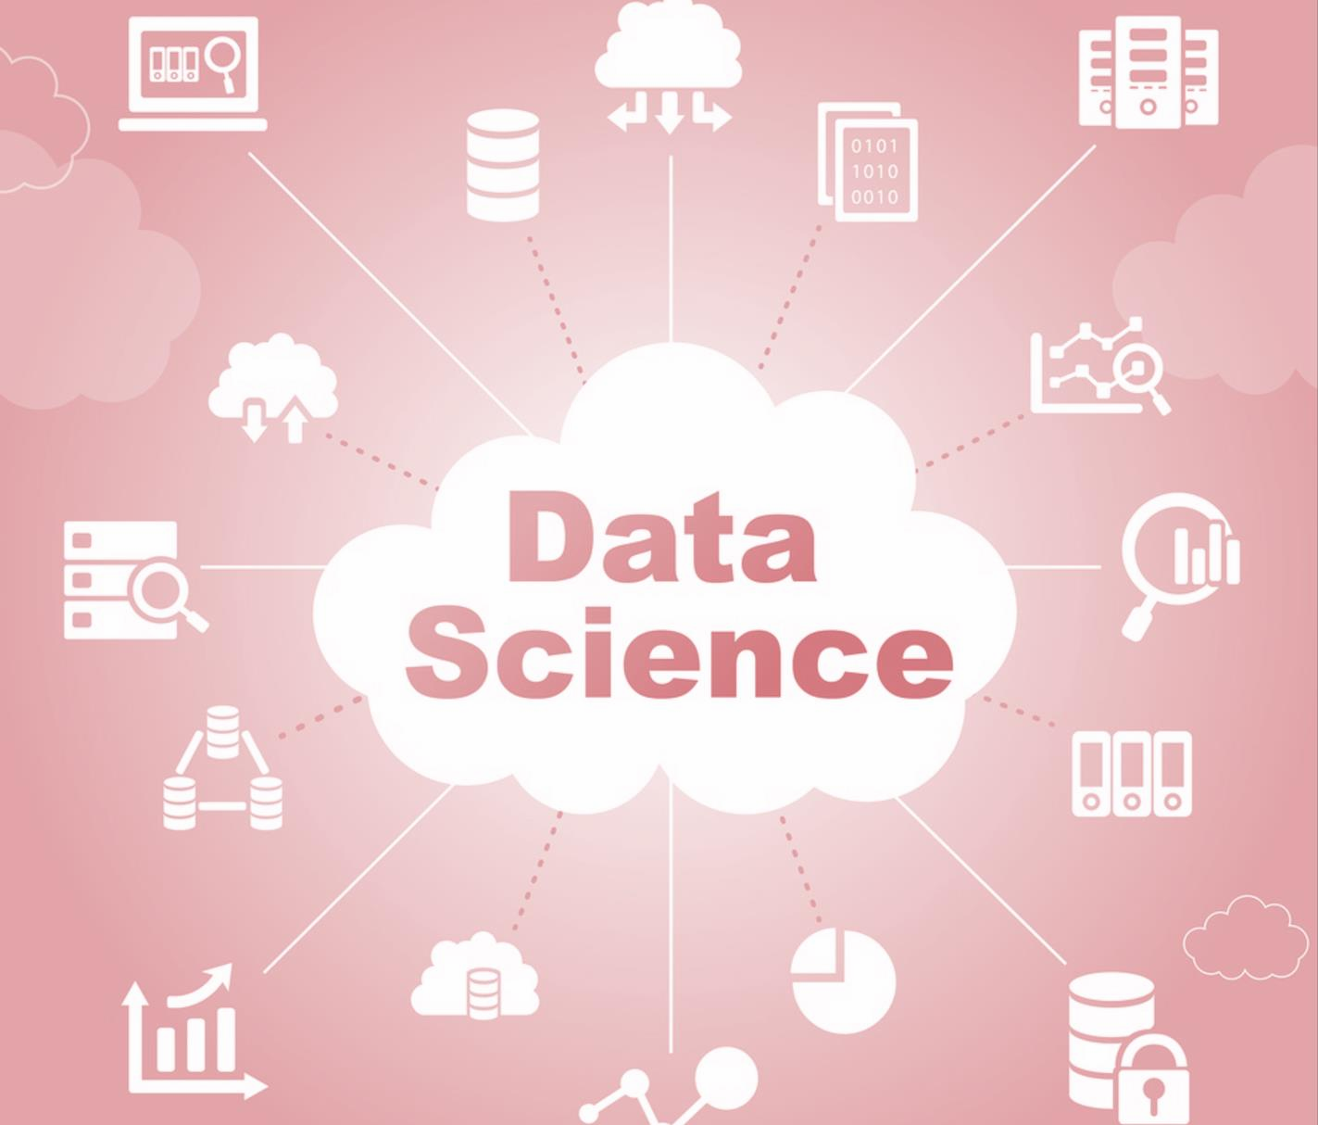

Slide 6
What is Data Science?
Data science is a multi-disciplinary field
Uses scientific methods, processes, algorithms and systems
Extracts knowledge and insights from data in various forms, both structured and unstructured

Slide 7
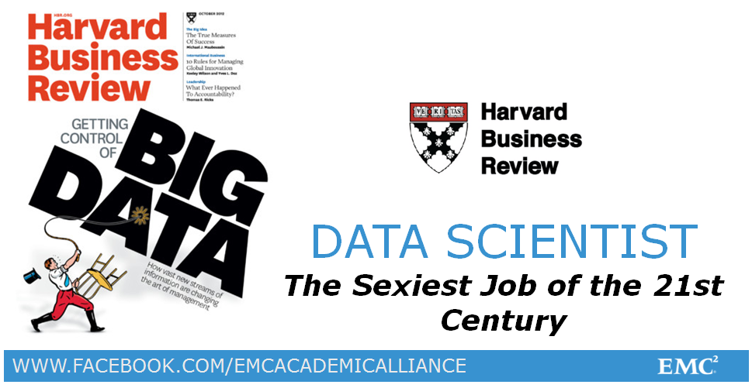

Slide 8
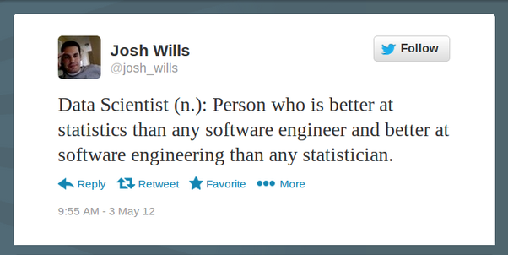

Slide 9
What Data Scientist do?
Product and Research
Sales and Marketing
Find better techniques
Make sure ML system was “smart” enough
Help the engineering team
Work with product managers to incorporate new improvements
Develop new products or features
Explain technology aspects to potential clients
Work with data set from a potential client
Share knowledge
Create visualization

Slide 10

Data Scientist skill set

Slide 11
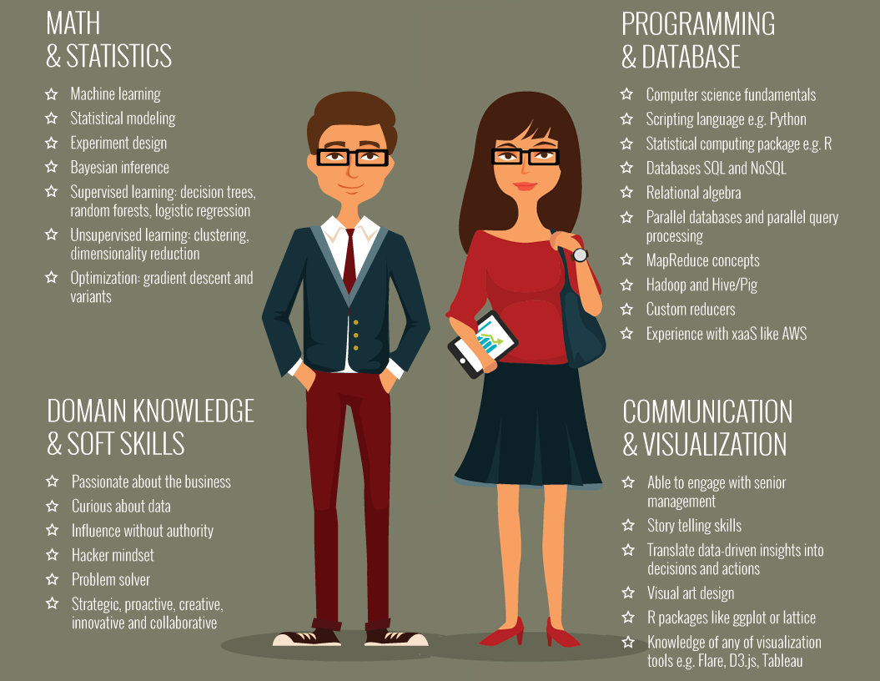
Data Scientist skill set

Slide 12
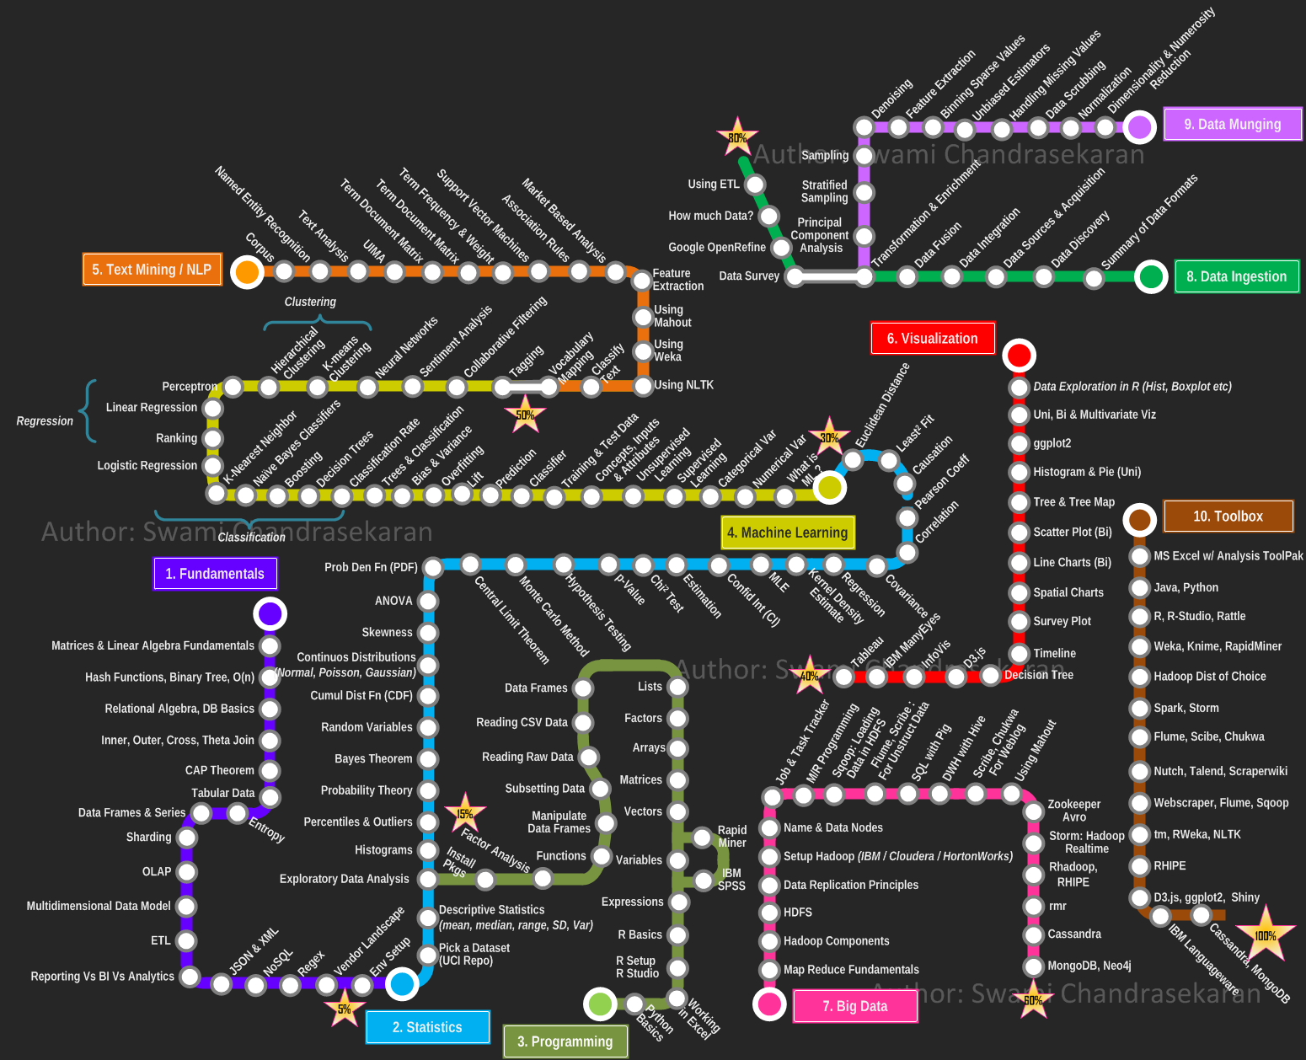

Slide 13
Data Science Level 1
-- Session 1--
Data science project cycle
Hung Nguyen
TIC Data Team Lead
13

Slide 14
The Data Science Process
BUSINESS
MATH/STATISTICS
COMPUTER SCIENCE
Business Understanding
Data Munging
Model Deployment
Data Preparation
Model Training
Model Tracking
Model Evaluation

Slide 15
Business understanding
Determine
Understand
Map
What does the client want to achieve?
Reduce attrition
Customized targeting
Plan future media spend
Prevent fraud
Recommend Products
Understand success criteria.
List assumptions, constraints, and important factors.
Identify secondary or competing objectives.
Study existing solutions (if any).
Business Objective → Technical Objective
State the project objective in technical terms.
How data science project will help
Successful scenarios.

Slide 16
Data Preparation
IDENTIFY
COLLECT
ASSESS
VECTORIZE
Data sources, formats
Entity Relationship Diagram
Identify relevant data
Record unavailable data.
How long
Access or acquire all relevant data in a central location
Quality control checks and tests
Get familiar with the data.
Study seasonality.
Detect mistakes.
Check assumptions.
Review distributions.
Create the Analysis Dataset

Slide 17
Data munging (preprocessing)
Descriptive statistics
Correlation analysis
Impute missing values
Trim extreme values
Process categorical attributes
Transformations (square, log, etc.)
Multicollinearity: reduce redundancy
Create additional feature
Interactions
Normalization (scaling)

Slide 18
Time
Spent
80%
20%
Data
Munging
Model Building

Slide 19
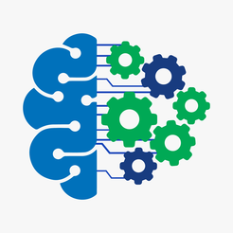

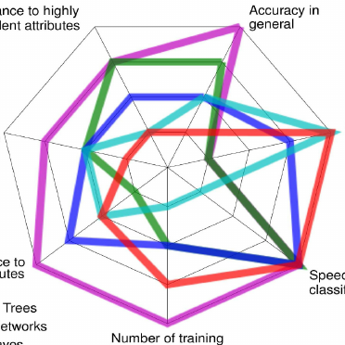
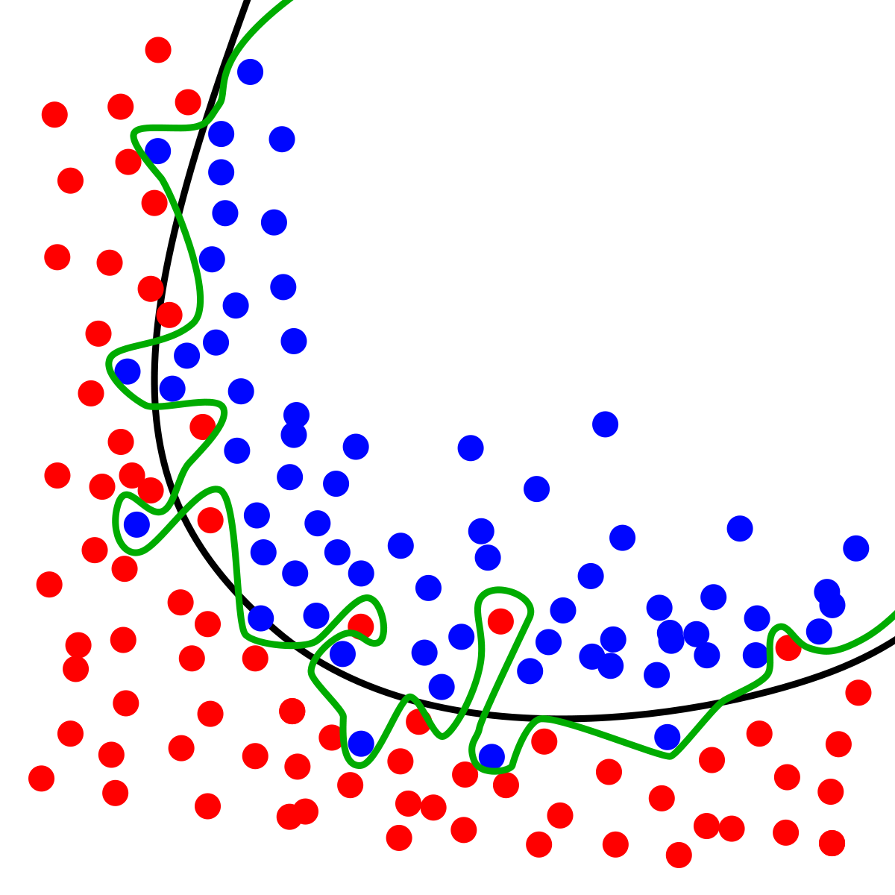
Model training
Try more than one machine learning technique.
Fine-tune parameters.
Assess model performance.
Avoid Over-fitting.

Slide 20
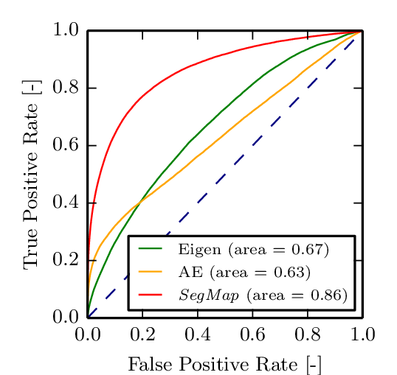
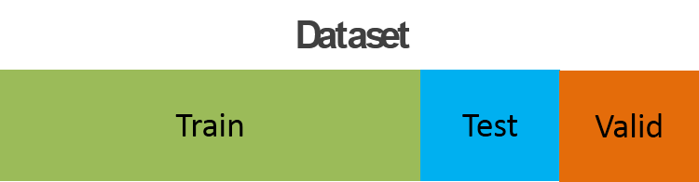
Model Evaluation
MODEL SELECTION
ASSESSMENT
PRESENTATION
Law of Parsimony: simple is better
Execution time
Deployment complexity

Slide 21
Model Deployment
Model production cycle
Scoring code, or publish model as a web service
Model Documentation (Technical Specifications)
Reproducibility
Model Persistence vs. Model Transience

Slide 22
Model Tracking
MONITOR
MAINTAIN
TEST
Model performance over time
Predictor distribution
Model maintenance plan
Adding new data sources
Version control
Experimental Design (A/B tests, Fractional Factorial)

Slide 23
Data Science Process: Recap
Business Understanding | Data Preparation | Data Munging | Model Training | Model Evaluation | Model Deployment | Model Tracking
Determine
Understand
Map
Evaluate
Peer Review
Present
Deploy
Document
Identify
Impute
Train
Monitor
Collect
Transform
Assess
Maintain
Assess
Reduce
Select
Test
Vectorize
DISCUSS COLLATE WRANGLE PERFORM COMMUNICATE EXECUTE TRACK

Slide 24
Data Science Level 1
-- Session 1--
Basic statistical concepts
Hung Nguyen
TIC Data Team Lead
24

Slide 25
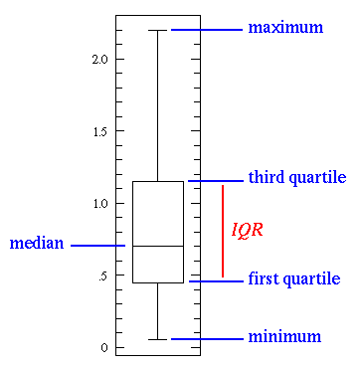
Statistical Features
min, max, mean, median, mode, standard deviation, first & third quartiles
the first stats technique to apply when exploring a dataset
easy to understand and implement in code

Slide 26
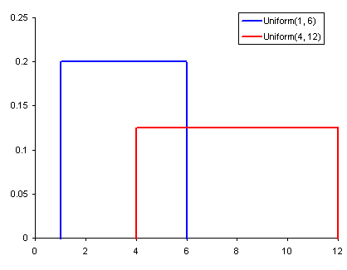
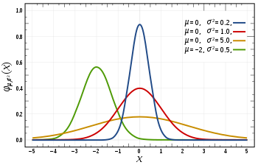
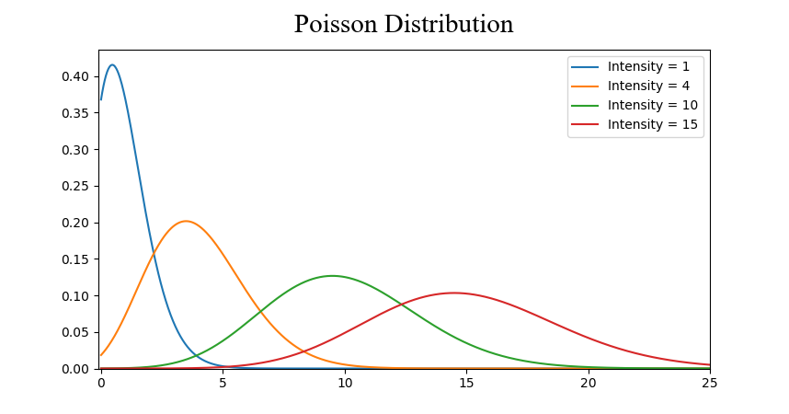
Probability Distributions
Uniform
Gaussian
Poisson
Probability - percent chance that some event will occur

Slide 27
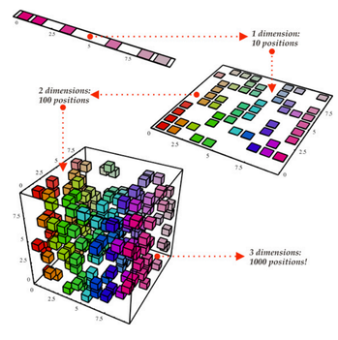
Dimensionality Reduction
Techniques:
Feature pruning
Principal component analysis (PCA)

Slide 28

Over and Under Sampling
usually use in imbalanced classification problem

Slide 29
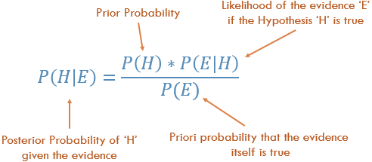
Bayesian Statistics

Slide 30
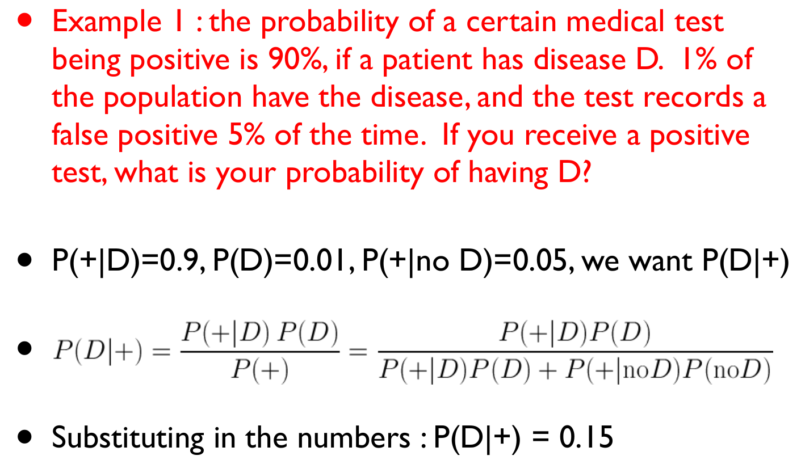
Bayesian Statistics - Example

Slide 31
Data Science Level 1
-- Session 1--
Introduction to Python
Hung Nguyen
TIC Data Team Lead
31

Slide 32
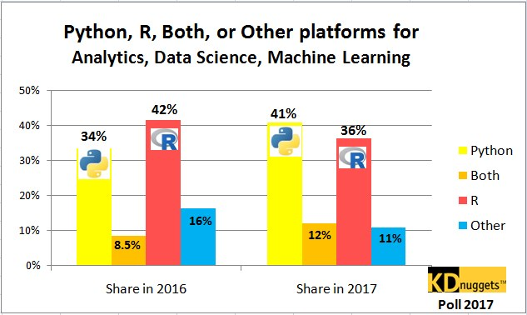

Slide 33
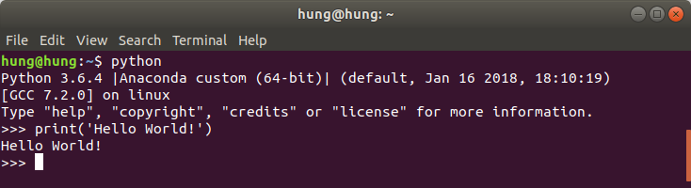
Why Python for Data Science?
Python’s inherent readability and simplicity make it relatively easy to pick up
Large amount of dedicated analytical libraries and open-source communities
Millions of users who are happy to offer advice or suggestions
Supports object-oriented programming, structured programming, and functional programming patterns

Slide 34

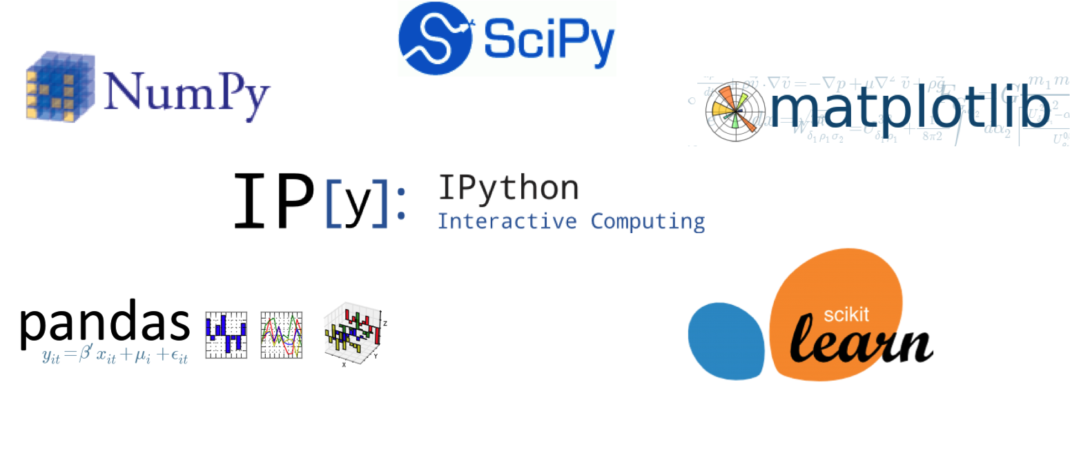
Python basic libraries for Data Science
Install: $ pip install <library_name>
Use: >>> import <library_name>

Slide 35
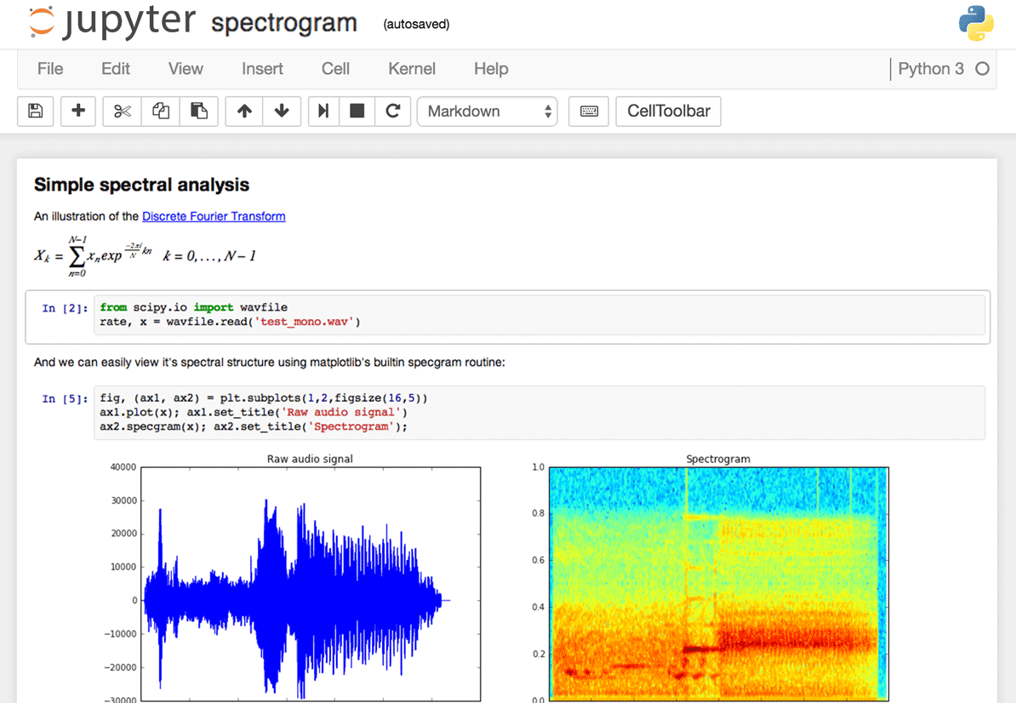

IDE: Python Notebook
Install: $ pip install jupyter
Run: $ jupyter notebook

Slide 36
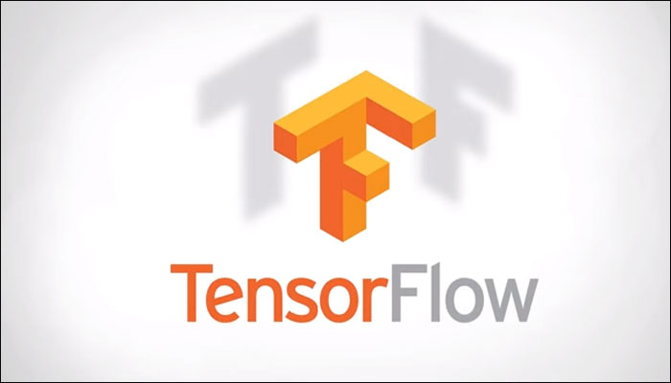



Libraries/APIs for Big Data & Deep Learning

